Slide 1


Rakuten Mobile Inc. Website
Localization Project
Technical Review
17 June 2024
Presented By:
Ebrima Hydara IDX

Slide 2
Agenda
Overview
Proposed Solutions
RMI Current Setup Review
Suggestions & Agreements
Project Timeline
Questions & Open Discussion
Contact Information

Slide 3
Overview (today’s target)
To introduce the proposed solutions for the project
To discuss & review RMI’s current source code structural issues
To discuss and agree on strategies to mitigate the issues
Agree on a timeline
Ask questions and discuss any concerns
Share point of contact information

Slide 4
Proposed Solutions
AutoLoc Script App:
Functionality: Automates the extraction and localization process for HTML files
Benefits: Reduces manual effort, enhances accuracy, and speeds up the localization cycle.
AutoLoc Plugin App:
Functionality: Seamlessly integrates with host CMS platforms for dynamic content localization.
Benefits: Provides real-time localization updates, maintaining content relevance across multiple languages.

Slide 5


Proposed Solutions: AutoLoc Script
Modified HTML
<!DOCTYPE html>
<html lang="ja">
<head>
<meta charset="UTF-8">
<title id="str-0001">
サンプ ルページ
</title>
</head>
<body>
<h1 id="str-0002">
ようこそ
</h1>
<p id="str-0003">
ローカライゼーションの 世界へようこそ
</p>
</body>
</html>
Source Code Root
Folders
Modify
HTML
AutoLoc
Files
Extract
Texts
Locales Folder
ja.json
JSON
en.json
zh.json
Save Extracted Texts to
JSON files
etc…
These texts are moved to
JSON files with their respective
elements’ IDs
HTML
gets texts
from JSON

Slide 6
Proposed Solutions: AutoLoc Script + TMS
Source Code Root
Translation Management System
Folders
Modify
HTML
AutoLoc
Files
Translate
Review
Edit
Approve
Evaluate
Extract
Texts
Locales Folder
ja.json
JSON
en.json
zh.json
Save Extracted Texts to
JSON files
etc…
Get JSON files for translation
Merge translated JSON files in source code

Slide 7
Proposed Solution: AutoLoc Plugin + TMS
CMS
Dynamic
Content
Workflow
Translation Management System
CMS
Backend
Logic
API
Data
Translation
Workflow
Translate
Review
Edit
Approve
Evaluate
Data Flow
CMS
Database
AutoLoc
Plugin
Data Flow

Slide 8
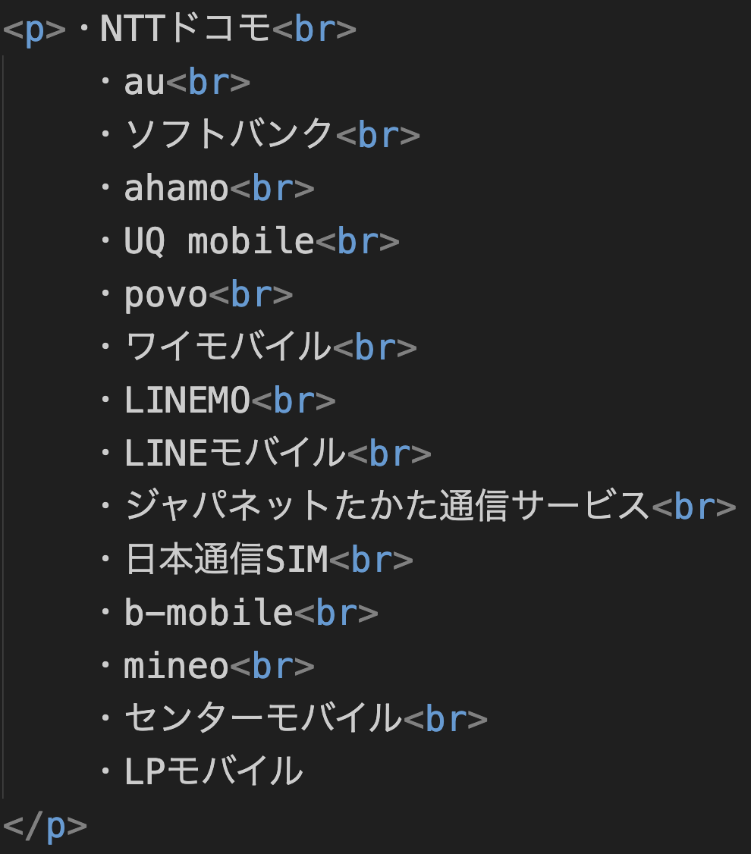
RMI Current Setup: HTML Issues
Issue:
<br> tags break context for translation
TMS cannot receive text with <br> tags
Suggestion:
Remove <br> tags in text and adopt <pre>…</pre> element to maintain format without breaks

Slide 9
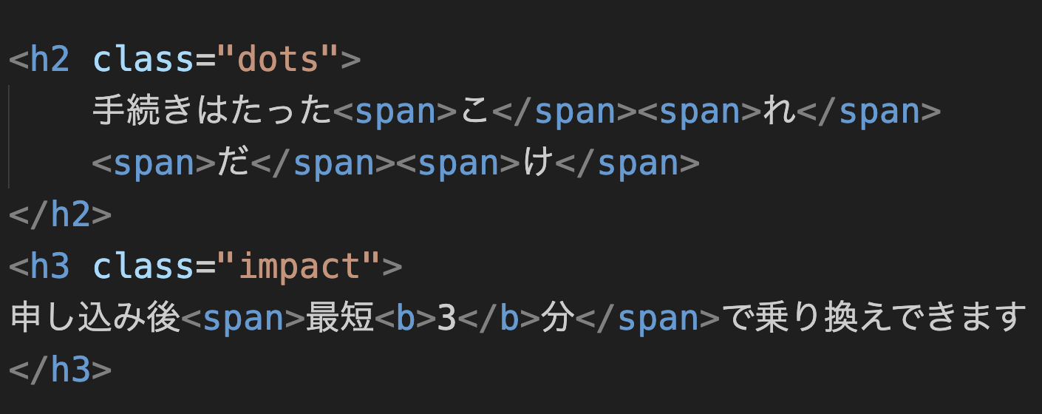
RMI Current Setup: HTML Issues
Too many <span> elements
Issue: Breaks translation context
Suggestion: Minimize span tags

Slide 10
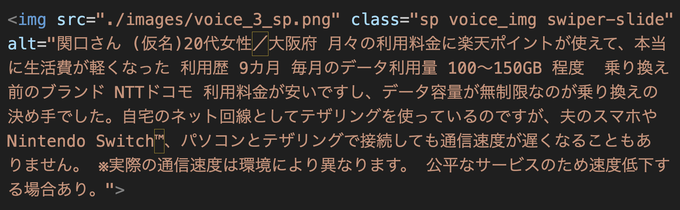
RMI Current Setup: HTML Issues
Images with very long alt values
Issue: May require translation and can be resource intensive on language switch
Suggestion: Load images based on the locale

Slide 11
RMI Current Setup: HTML Issues
Every HTML file is an index.html file
Issue:
Each HTML file in the source code will require an independent logic to render the same language selection switch.
Migrate to templating engines that accommodate inheritance: child templates rendered from one main parent template bearing global UI components → for future website versions.

Slide 12
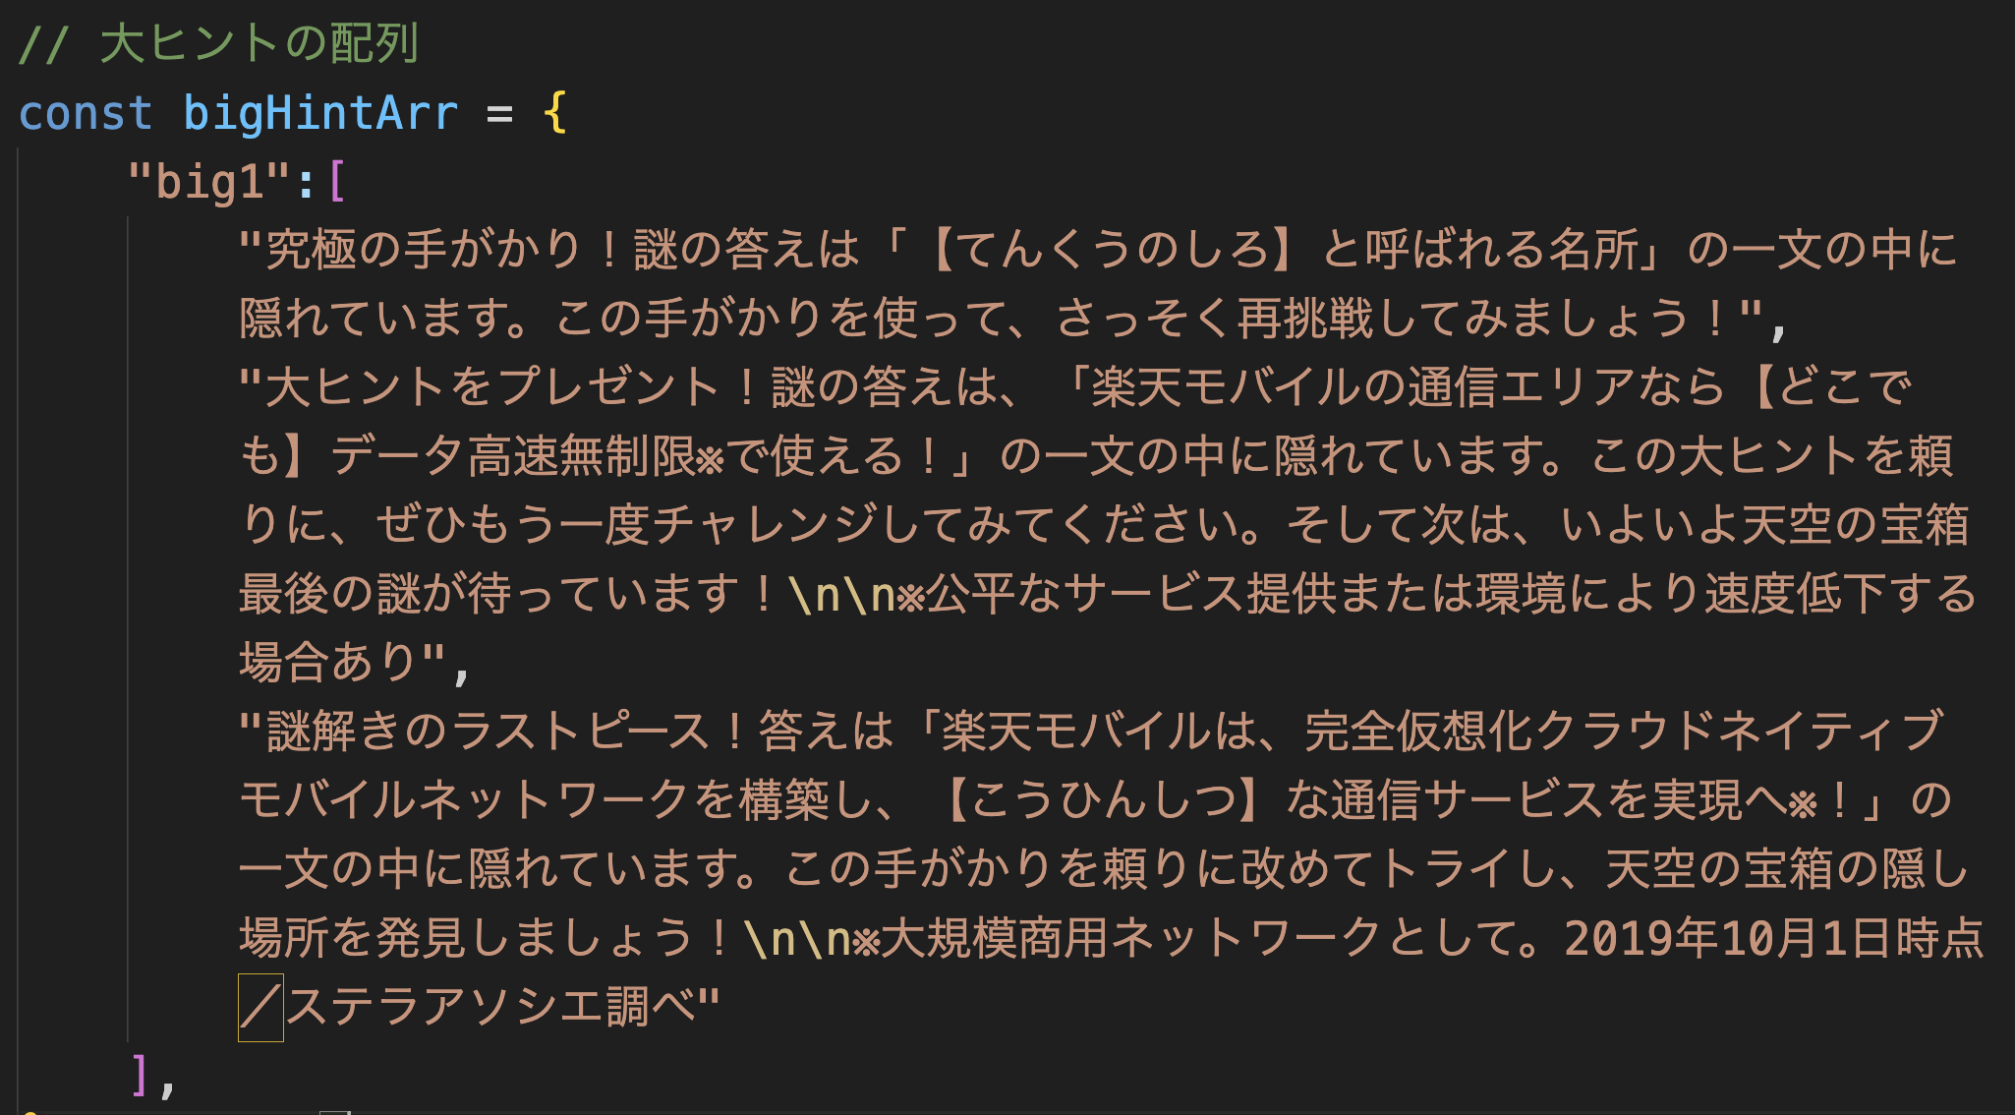
RMI Current Setup: JS, JSON, CSV Issues
JavaScript
Rendered
Content

Slide 13
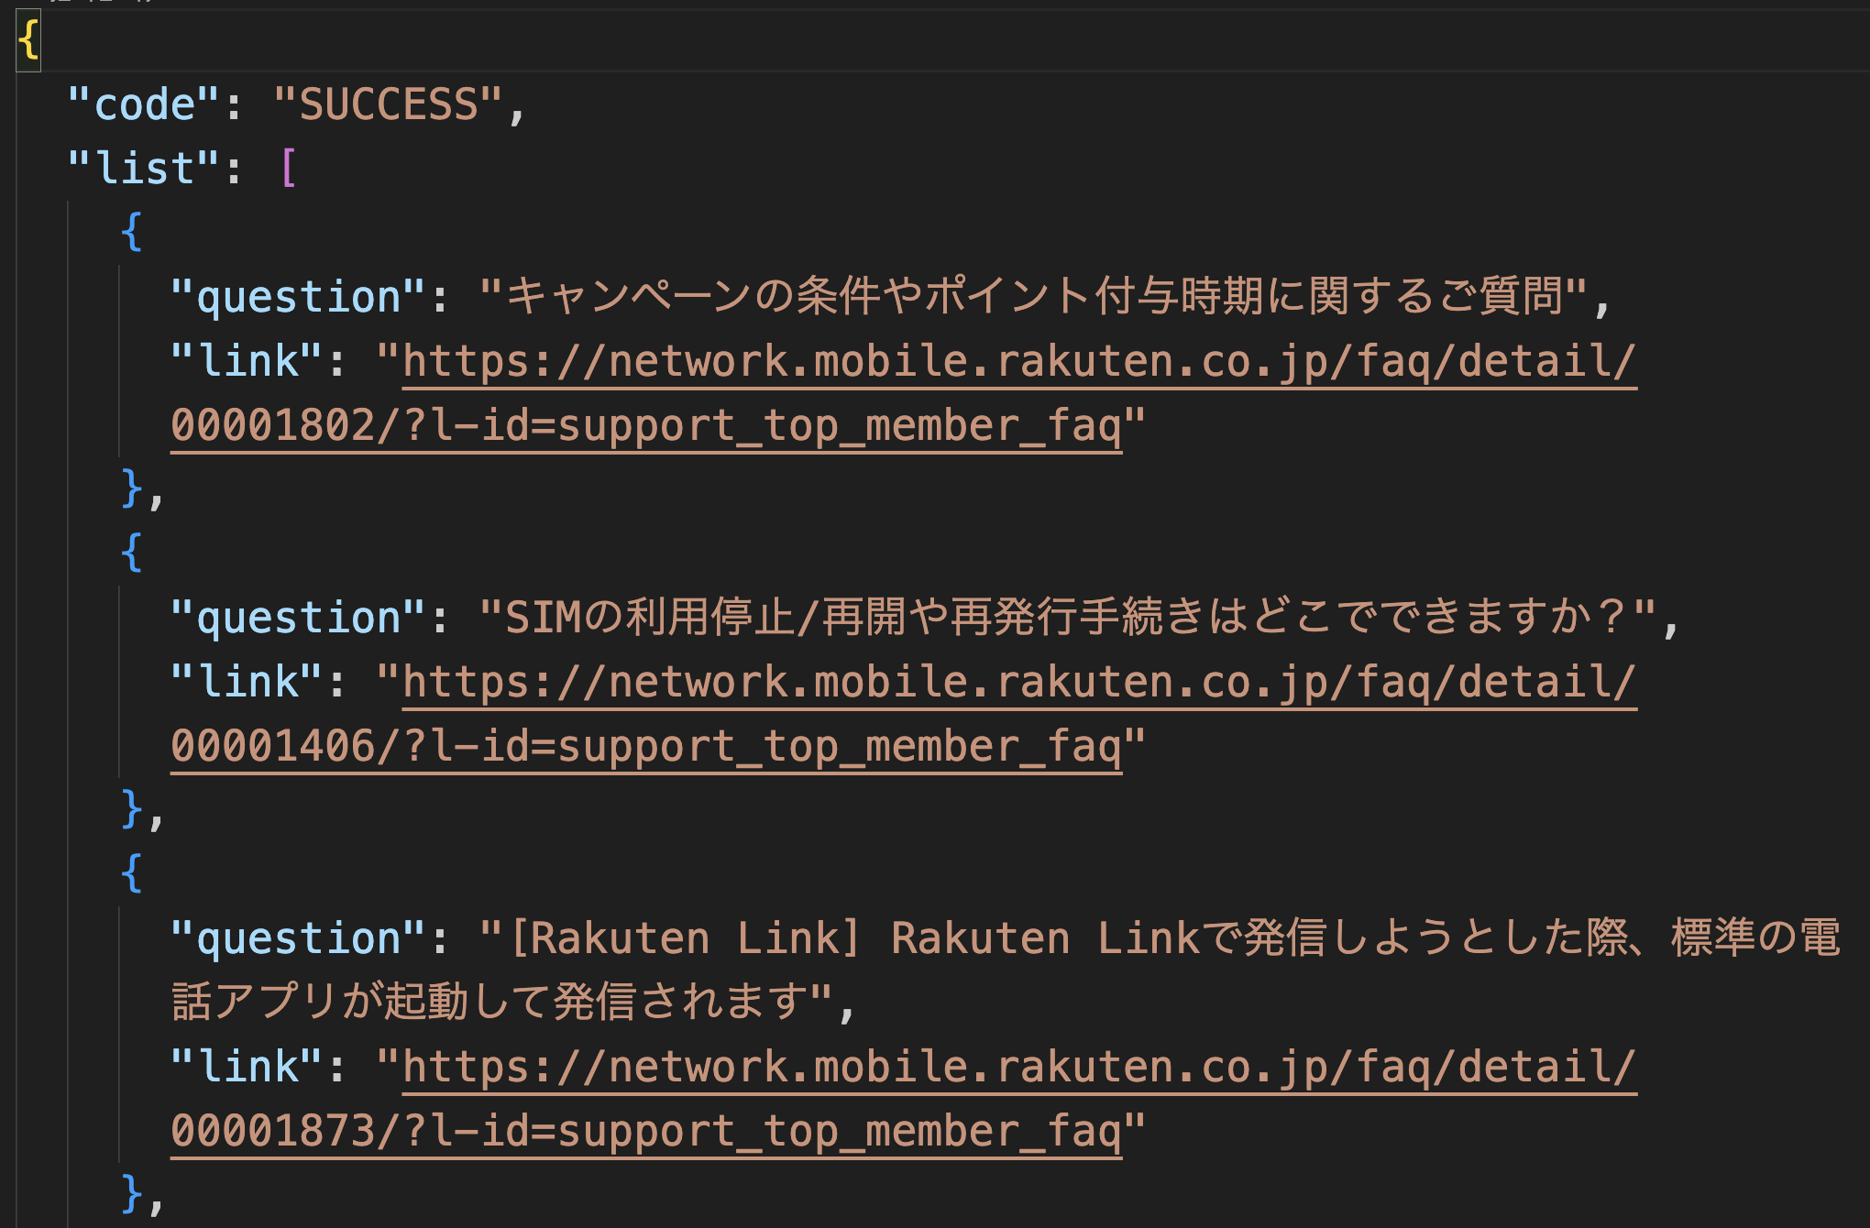
RMI Current Setup: JS, JSON, CSV Issues
JavaScript (JSON)
Rendered
Content

Slide 14
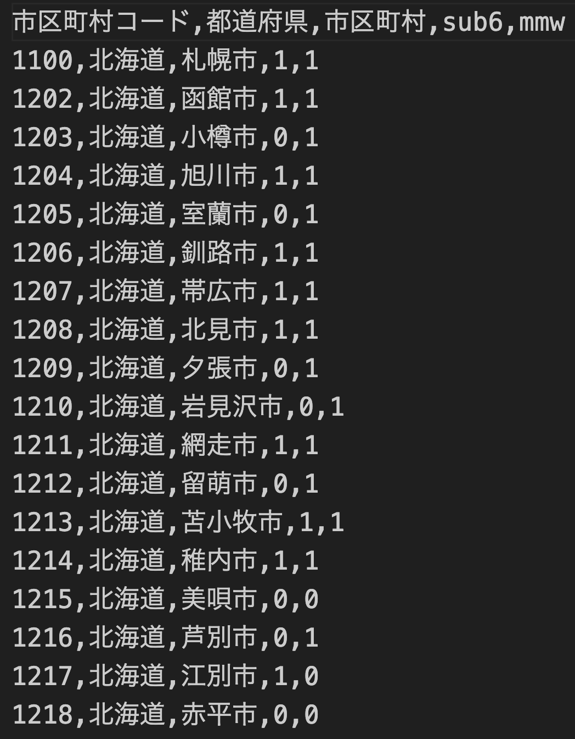
RMI Current Setup: JS, JSON, CSV Issues
CSV Rendered Content
Note: PDFs are out of scope
of the solutions

Slide 15
RMI Current Setup: CMS/Backend
OmniReach CMS: Messaging/chat platform
Source code is required for localization plugin integration
Concrete 5 CMS: Website platform
Source code is required for localization plugin integration
Hikeshiya:
I couldn’t find a link to it
DevOps:
Azure DevOps Service? (may not be running on CMS)
AI Team:
It may not be running on CMS

Slide 16
Suggestions & Agreement
HTML files can be automatically localized without breaking source code.
JSON files may be directly replicated into required locale versions and translated without breaking source code.
JS files may only be manually localized and translated for each required locale without breaking source code. It is advisable to load rendered texts from JSON files instead of hard-coding them in the JS file.
CSV files may be converted to JSON for translation, however, there is no guarantee to translate only texts.

Slide 17
Project Timeline
Phase 1:
AutoLoc Script App & Integration: by the end of July (tentatively)
Phase 2:
AutoLoc Plugin App & Integration: by the end of October (tentatively)
The timeline will be finalized after agreement on the approach and solution scope.

Slide 18
Questions & Open Discussion
What is the solution scope expected?
HTML only?
HTML and others (JS, JSON, and CSV)?
What are the CMS platforms in scope?
Is there any current expertise for customizing the said CMSs?
Are there any available source codes?
Any available/known plugins for localization?
The need to adapt to standardized localization structure in all files in the future: HTML, JS, and JSON.

Slide 19
Contact Information
I will require a point of contact/person in contact for subsequent updates and decisions
My internal email: ts-ebrima.hydara@rakuten.com

Slide 20
Thank You

